Slide 1
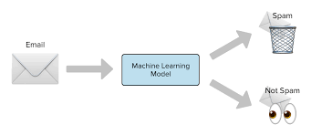
Spam Detection Classifier project
Prepared by: Nasim Patil
SME Name: Ms.Khushboo Garg

Slide 2
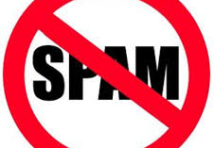
EMAIL SPAM CLASSIFICATION
Spam Filtering:
Spam Detector is used to detect unwanted, malicious and virus infected texts and helps to separate them from the nonspam texts. It uses a binary type of classification containing the labels such as ‘ham’ (nonspam) and spam. Application of this can be seen in Google Mail (GMAIL) where it segregates the spam emails in order to prevent them from getting into the user’s inbox.
The SMS Spam Collection is a set of SMS tagged messages that have been collected for SMS Spam research. It contains one set of SMS messages in English of 5,574 messages, tagged according to ham (legitimate) or spam.

Slide 3
Data Set Description
The files contain one message per line. Each line is composed by two columns:
v1 contains the label (ham or spam)
v2 contains the raw text.
A collection of 5573 rows of SMS spam messages was manually extracted from the Grumbletext Web site. This is a UK forum in which cell phone users make public claims about SMS spam messages, most of them without reporting the very spam message received. The identification of the text of spam messages in the claims is a very hard and time-consuming task, and it involves carefully scanning hundreds of web pages.
A subset of 3,375 SMS randomly chosen ham messages of the NUS SMS Corpus (NSC), which is a dataset of about 10,000 legitimate messages collected for research at the Department of Computer Science at the National University of Singapore. The messages largely originate from Singaporeans and mostly from students attending the University. These messages were collected from volunteers who were made aware that their contributions were going to be made publicly available.

Slide 4
Model Building Phase
After collecting the data, you need to build a machine learning model. Before model building do all data pre-processing steps. Try different models with different hyper parameters and select the best model.
Follow the complete life cycle of data science. Include all the steps like
1. Data Cleaning
2. Exploratory Data Analysis
3. Data Pre-processing
4. Model Building
5. Model Evaluation
6. Selecting the best model

Slide 5



EDA
SHAPE OF THE DATASET.
INFORMATION OF THE DATASET.
DATA CLEANING.

Slide 6
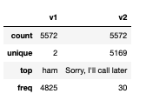
Descriptive Statistic:

Slide 7
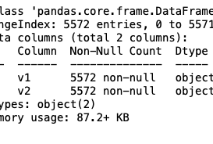
Information of dataset:-

Slide 8
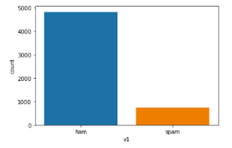
Visualization

Slide 9
Natural Language Processing (NLP)
Data Preprocessing
Stopwords
Punkt
wordnet
Converting to lower case
Removing the URL's
Removing the numbers
Dealing with Punctuation
Removing Stop word
Applying Lemmatization

Slide 10
Length before and after preprocessing
Original Length : 446422
Clean Length : 336896

Slide 11
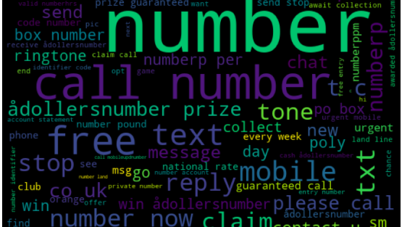
Word Cloud

Slide 12
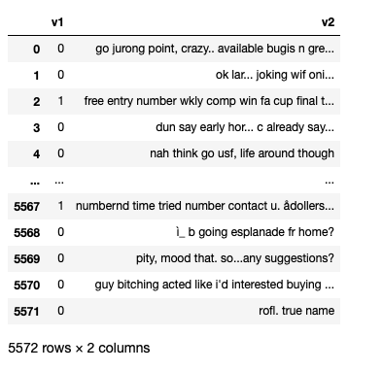
Final Dataset

Slide 13
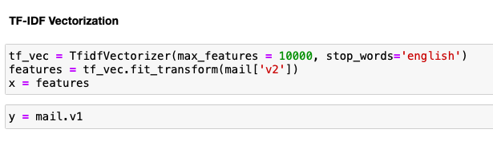
Encoding TF-IDF Vectorizer

Slide 14
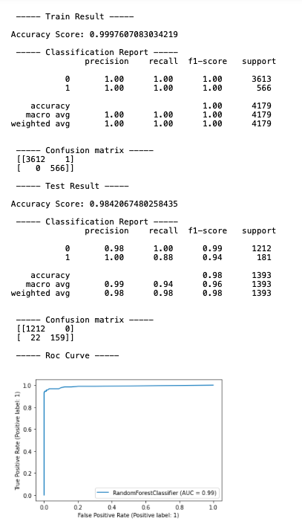
Best Model, Parameters & Score:
RandomForest Classifier.

Slide 15
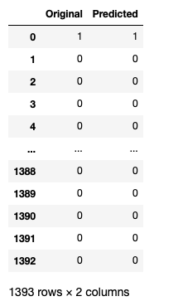
Original VS Predicted
- RandomForest Classifier.

Slide 16
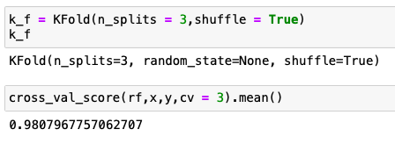
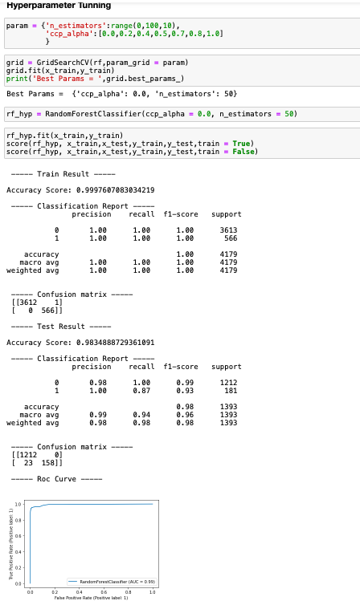
Hyperparameter Tuning & Cross-Validation

Slide 17
THANK YOU

